Slide 1
SERIAL COMMUNICATION

Slide 2
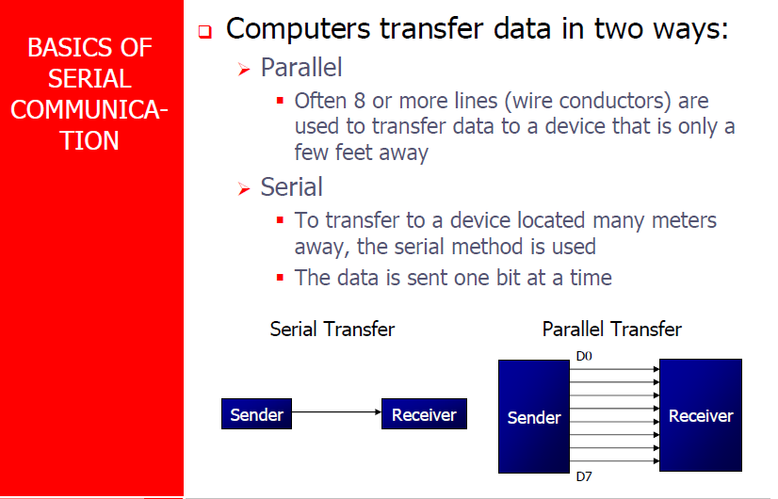

Slide 3
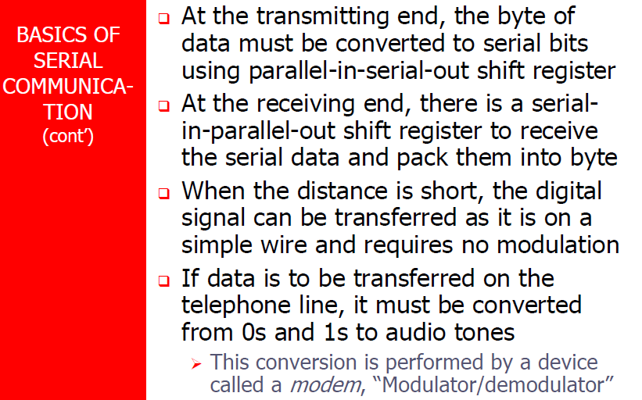

Slide 4
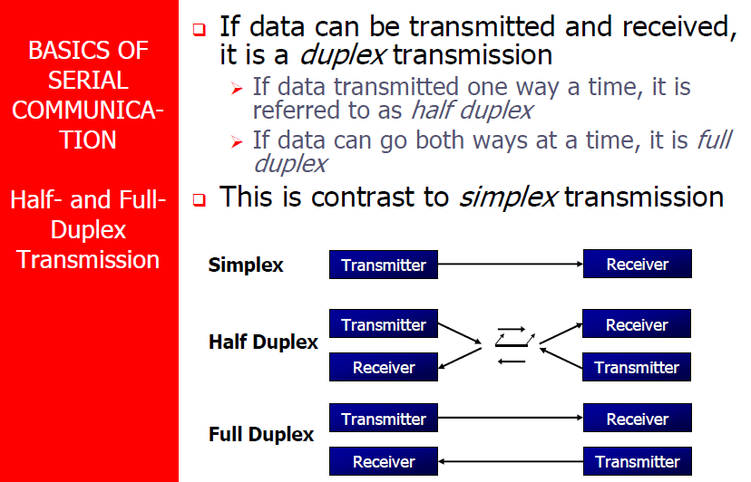

Slide 5
SECTION 10.1: BASICS OF SERIAL COMMUNICATION
Asynchronous serial communication and data framing
data coming in 0s and 1s
to make sense of the data sender and receiver agree on a set of rules
Protocol
how the data is packed
how many bits/character
when the data begins and ends

Slide 6
SECTION 10.1: BASICS OF SERIAL COMMUNICATION
Start and stop bits
asynchronous method, each character is placed between start and stop bits
called framing
start bit is always one bit
stop bit can be one or two bits
start bit is always a 0 (low)
stop bit(s) is 1 (high)
LSB is sent out first

Slide 7
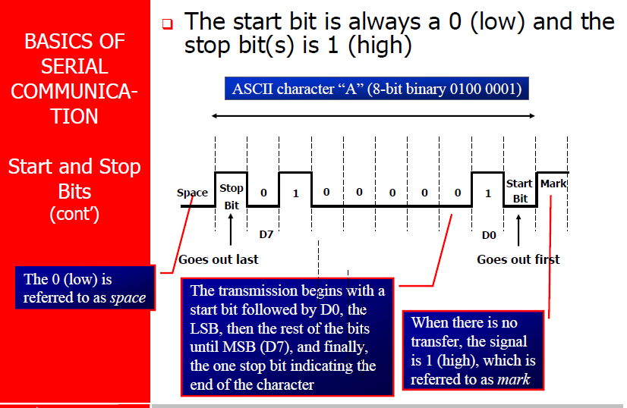

Slide 8
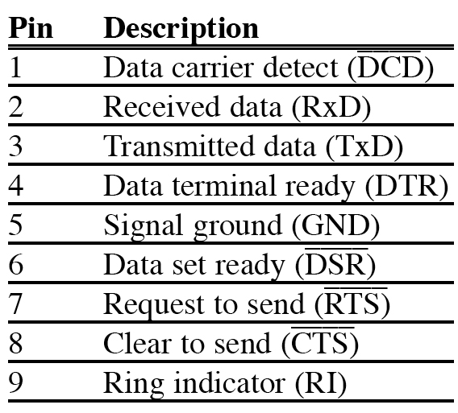
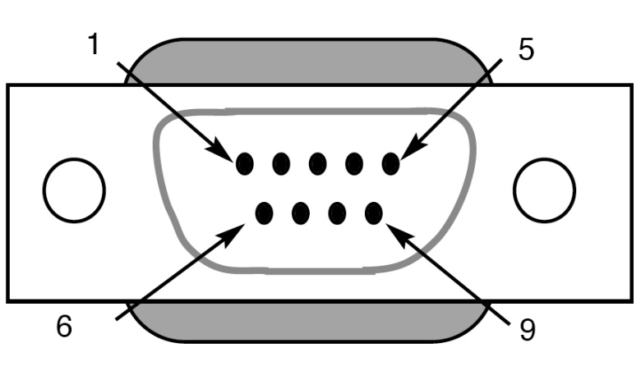
SECTION 10.1: BASICS OF SERIAL COMMUNICATION
Figure 10–5 DB-9 9-Pin Connector
Table 10–2 IBM PC DB-9 Signals

Slide 9
SECTION 10.1: BASICS OF SERIAL COMMUNICATION
Data communication classification
DTE (data terminal equipment)
DCE (data communication equipment)
DTE - terminals and computers that send and receive data
DCE - communication equipment responsible for transferring the data
simplest connection between a PC and microcontroller requires a minimum of three pins, TxD, RxD, and ground

Slide 10
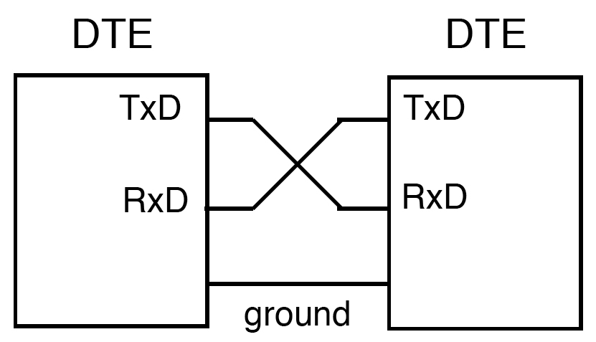
SECTION 10.1: BASICS OF SERIAL COMMUNICATION
Figure 10–6 Null Modem Connection

Slide 12
SECTION 10.1: BASICS OF SERIAL COMMUNICATION
Figure 10–5 DB-9 9-Pin Connector
Table 10–2 IBM PC DB-9 Signals

Slide 13
SECTION 10.1: BASICS OF SERIAL COMMUNICATION
Data communication classification
DTE (data terminal equipment)
DCE (data communication equipment)
DTE - terminals and computers that send and receive data
DCE - communication equipment responsible for transferring the data
simplest connection between a PC and microcontroller requires a minimum of three pins, TxD, RxD, and ground

Slide 14
SECTION 10.1: BASICS OF SERIAL COMMUNICATION
Figure 10–6 Null Modem Connection

Slide 15
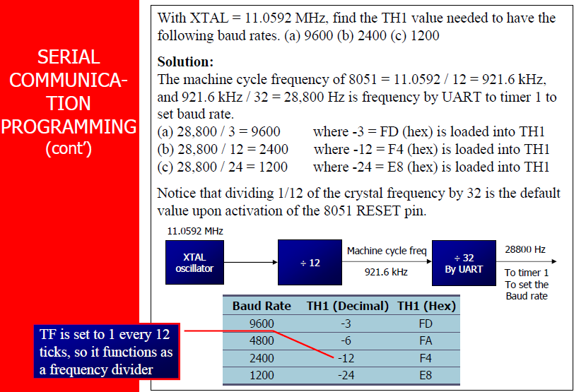

Slide 16
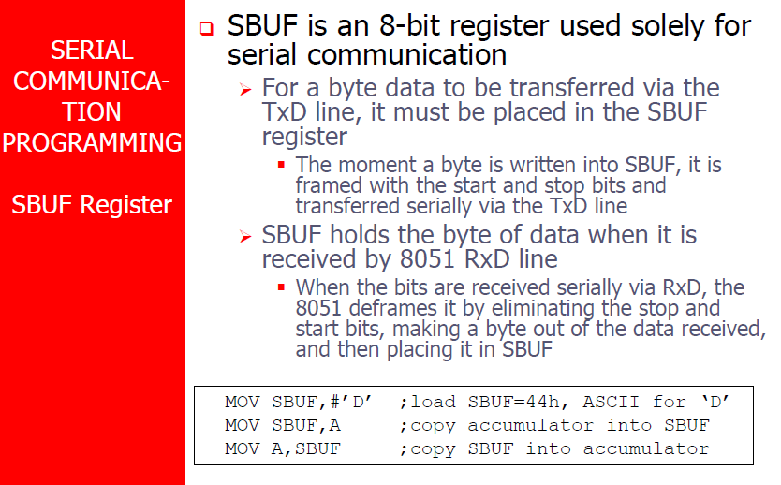

Slide 17
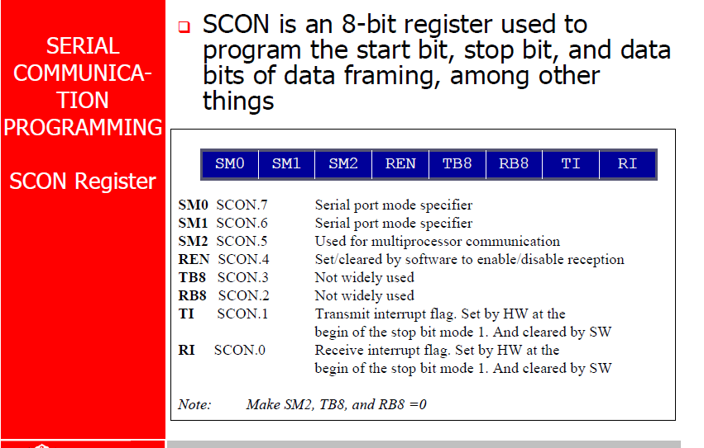

Slide 18
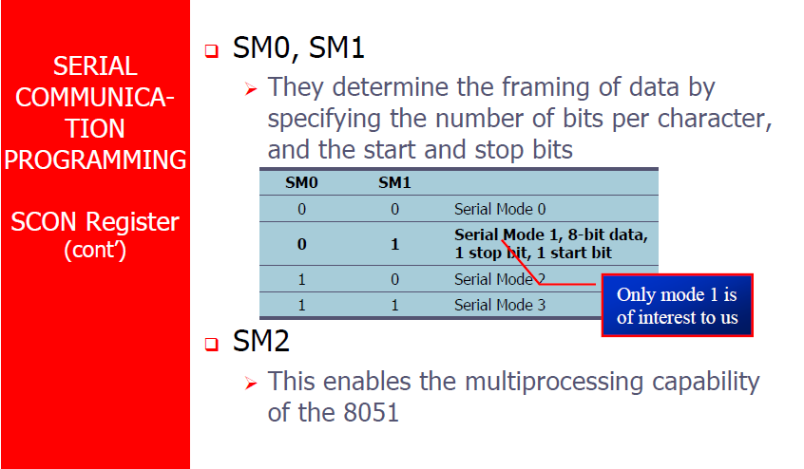

Slide 19
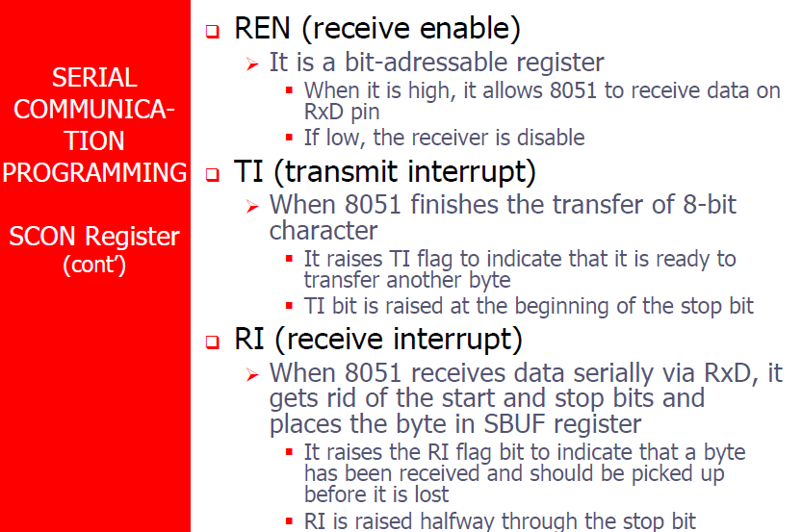

Slide 20
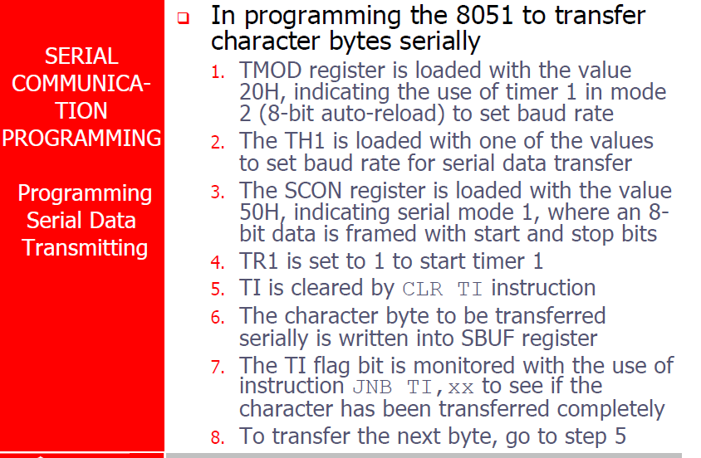

Slide 21
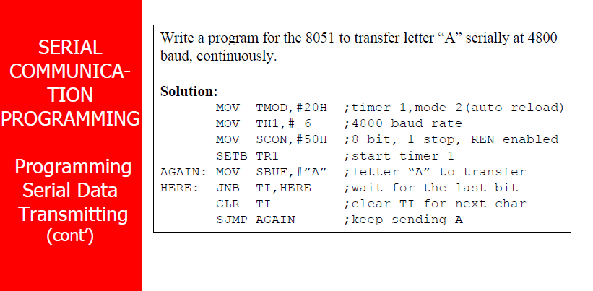

Slide 22
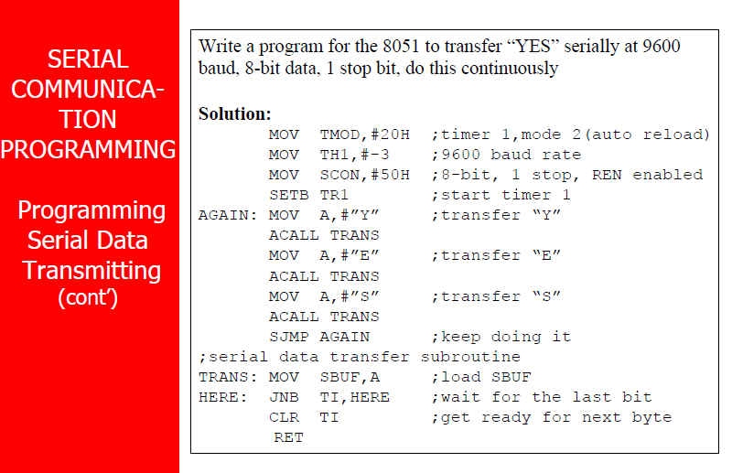

Slide 23
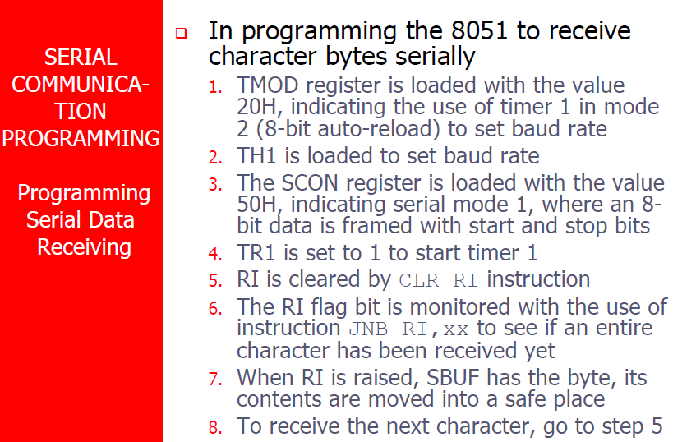

Slide 24
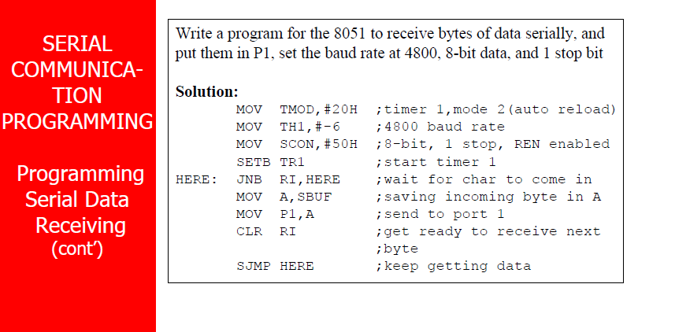

Slide 25
